Slide 1
Introduction to Version Control

Slide 2
Agenda
Overview of Version Control
Getting started with Git
Basic Git daily commands
Advanced Git commands
Git-related files
Resolve conflicts
Version Control and DevOps
Productivity tools

Slide 3
1.
Overview of Version Control

Slide 4
Version Control System
A software that records changes made to a set of files over time, allowing specific history to be recalled and restored as necessary.

Slide 5
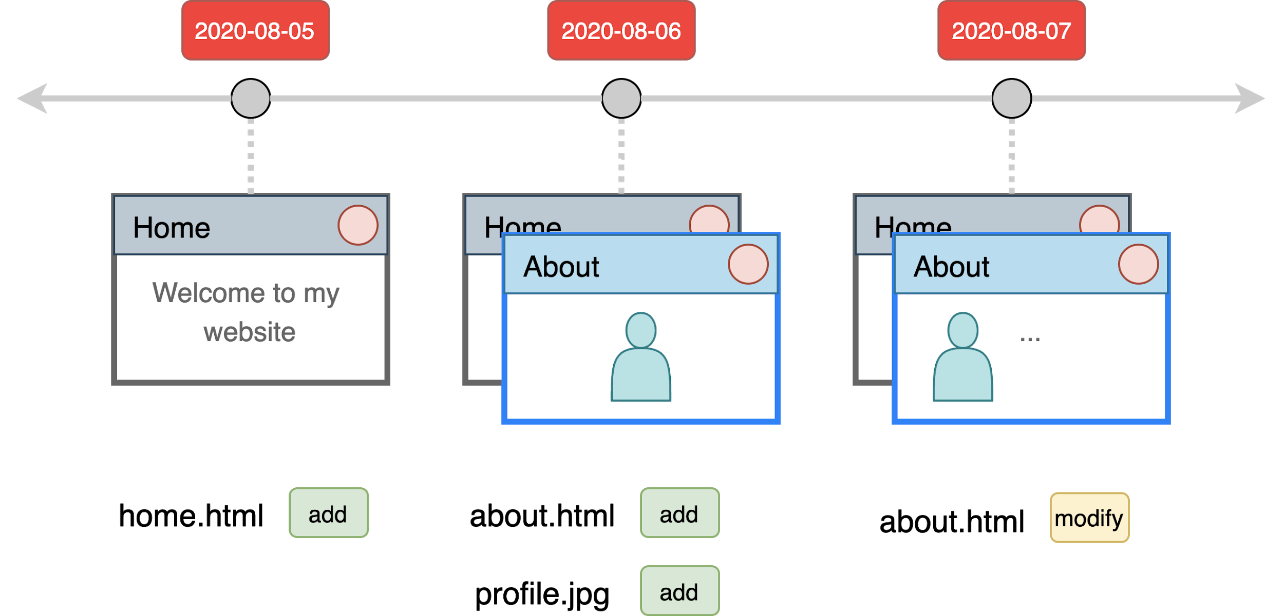
VCS example
Notes:
https://www.educba.com/git-alternatives/

Slide 6
VCS example
Notes:
https://www.educba.com/git-alternatives/

Slide 7
VCS example
Notes:
https://www.educba.com/git-alternatives/

Slide 8
1. 1
Use cases

Slide 9
Backups
Accidentally delete the file without backups.

Slide 10
Backups
Accidentally delete the file without backups.
Version Control makes backups, we can recover.

Slide 11
Backups (alternatives)
Manually backup files with timestamp
Online file hosting websites

Slide 12
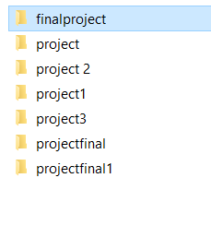
Backups (alternatives)
Notes:
https://medium.com/redefyn/why-git-and-github-165de17e7c9d

Slide 13
History and Changes
No clues what / why changes has been made.

Slide 14
History and Changes
No clues what / why changes has been made.
Version Control keeps a history line-by-line with a description.

Slide 15
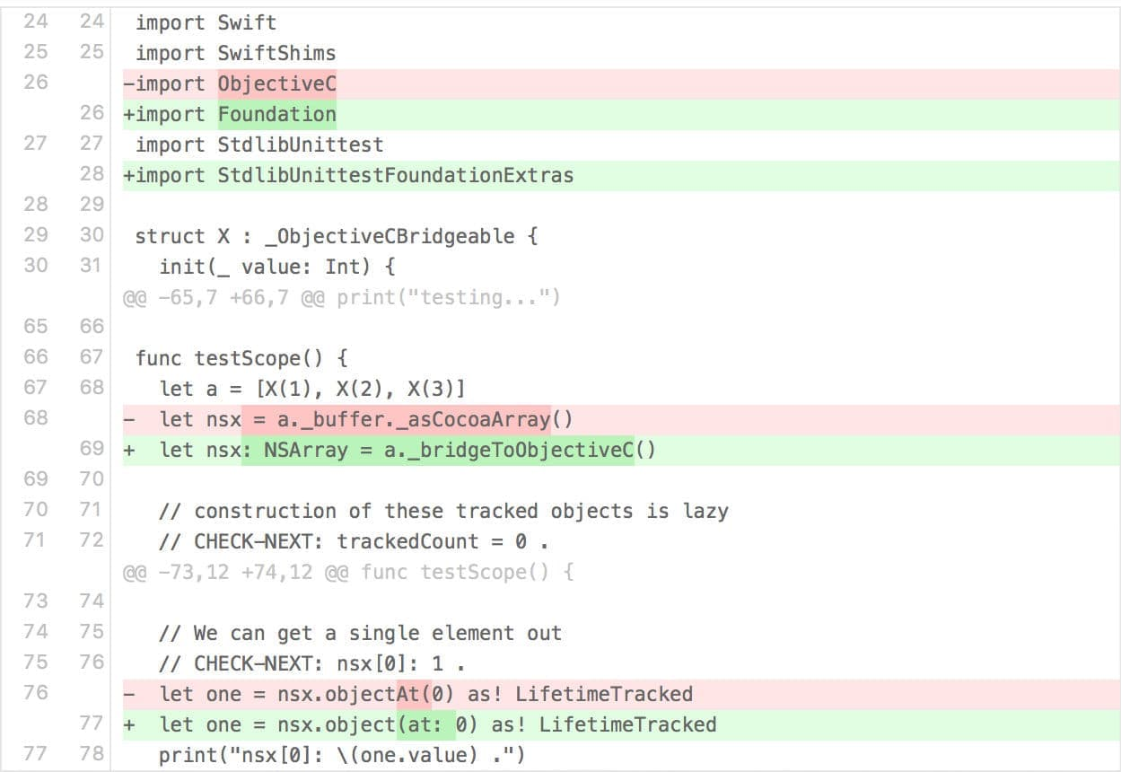
History and Changes

Slide 16
Experiment
In case of running some experiment, you need to create a new project since it will affect the existing main project.

Slide 17
Experiment
In case of running some experiment, you need to create a new project since it will affect the existing main project.
Version Control allows us to create experiment sections.

Slide 18
Collaboration
Unable to collaborate since the file belongs to one person at a time.

Slide 19
Collaboration
Unable to collaborate since the file belongs to one person at a time.
Version Controls allows us to work at the same file, at the same time.

Slide 20
Version Control offers ...
Backups
History records
Changes
Experiment
Collaboration

Slide 21
1. 2
Types of Version Control System

Slide 22
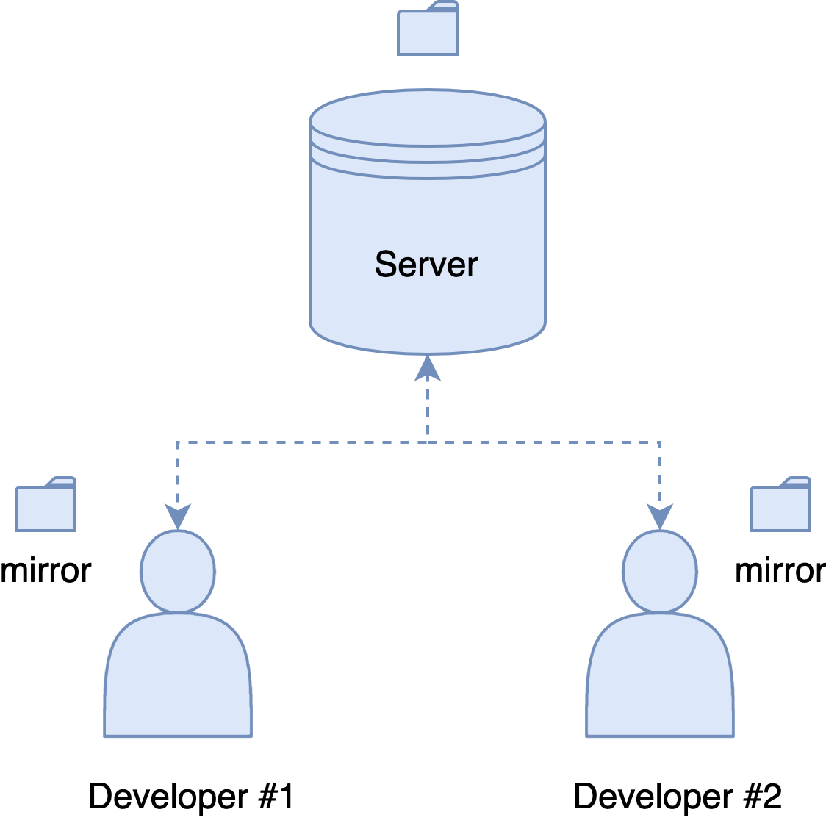
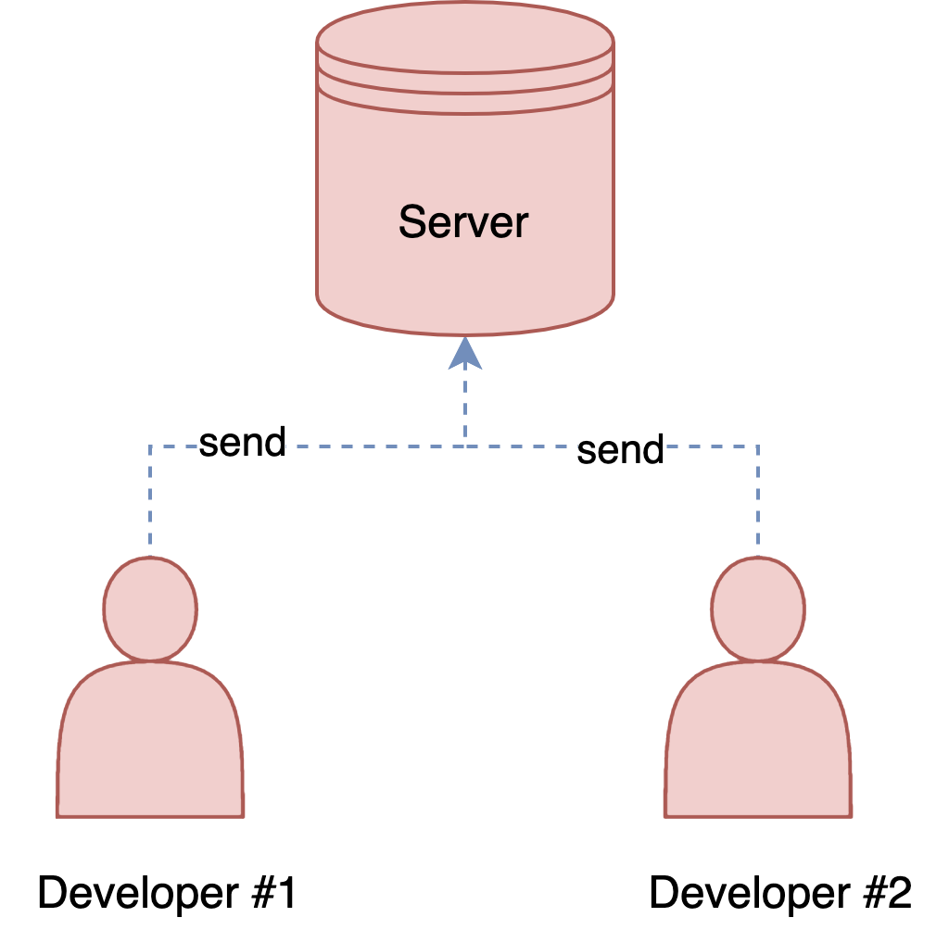
Centralized vs Distributed

Slide 23
Centralized vs Distributed
 | Centralized VCS | Distributed VCS
Speed | Slow | Fast
Offline mode | No | Yes

Slide 24
2.
Getting started with Git

Slide 25
Git gives you ...
Distributed version control system
Speed
Free and Open-source
Staging area

Slide 26
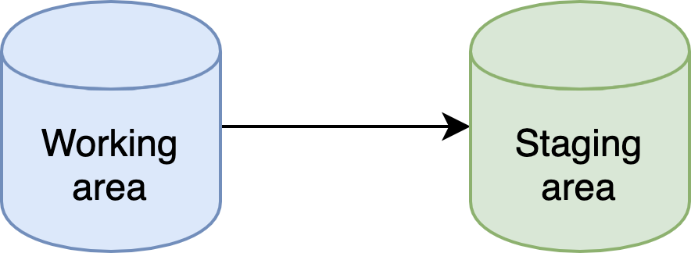
How Git works

Slide 27
Online shopping analogy
Add stuffs to cart
Order confirmation

Slide 28
Git hosting providers
GitHub
GitLab
Bitbucket
Azure DevOps

Slide 29
3.
Basic Git daily commands

Slide 30
Initializing
git init
Create an empty Git repository.

Slide 31
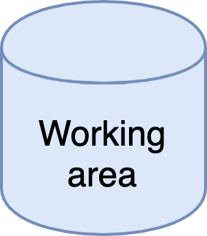
Initializing
git init

Slide 32
Staging
git add <file>
Indicate which files and their states are to be included in the next commit.

Slide 33
Staging
git add <file>

Slide 34
Status
git status
See the status of the repository.

Slide 35
Committing
git commit -m “<commit-message>”
Place copies (snapshots) of working directory back into the repository as a new version.

Slide 36
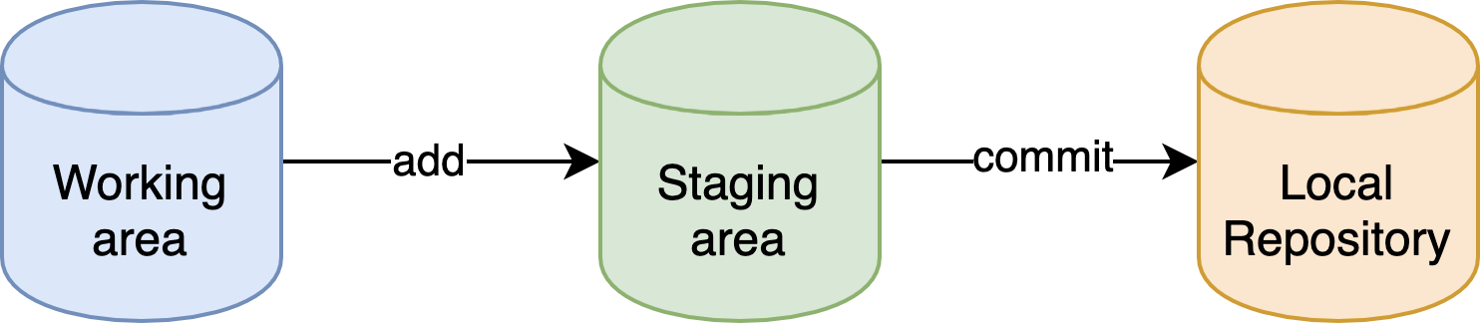
Committing
git commit -m “<commit-message>”

Slide 37
Syncing
git remote [add | set-url] <remote> <url>
Sync the local repository to the remote repository.

Slide 38
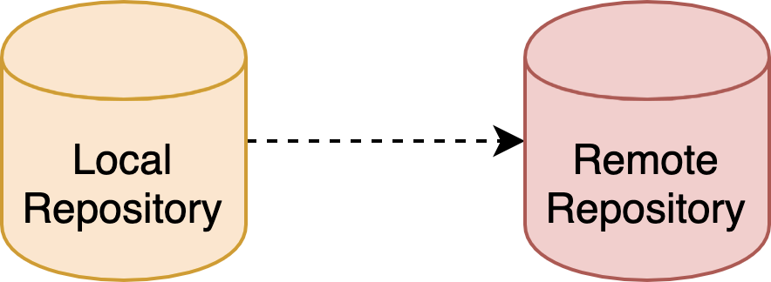
Syncing
git remote [add | set-url] <remote> <url>

Slide 39
Pushing
git push -u <remote> <branch>
Push changes up to a branch of a remote repository.

Slide 40

Pushing
git push -u <remote> <branch>

Slide 41
Pulling
git pull <remote> <branch>
Pull changes from (a branch of) a remote repository.

Slide 42
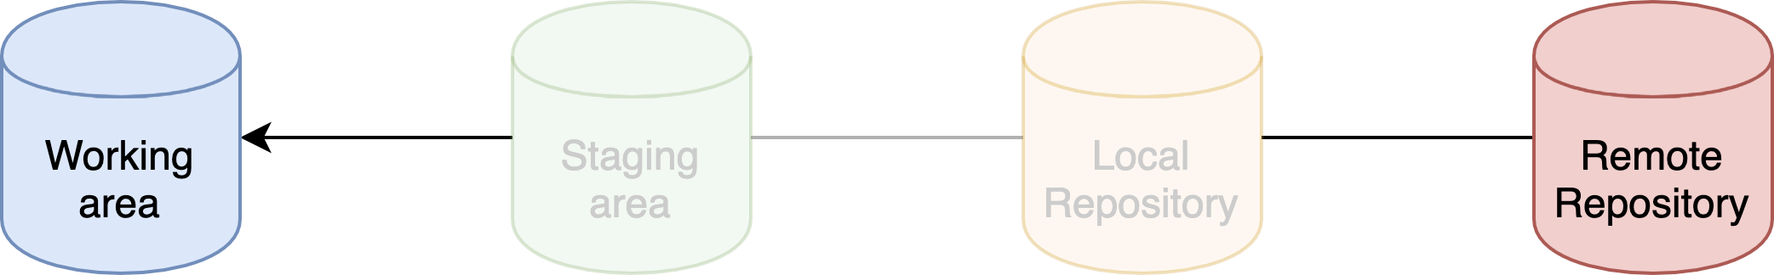
Pulling
git pull <remote> <branch>

Slide 43
Cloning
git clone <remote-url>
Get your own local copy of an existing repository.

Slide 44
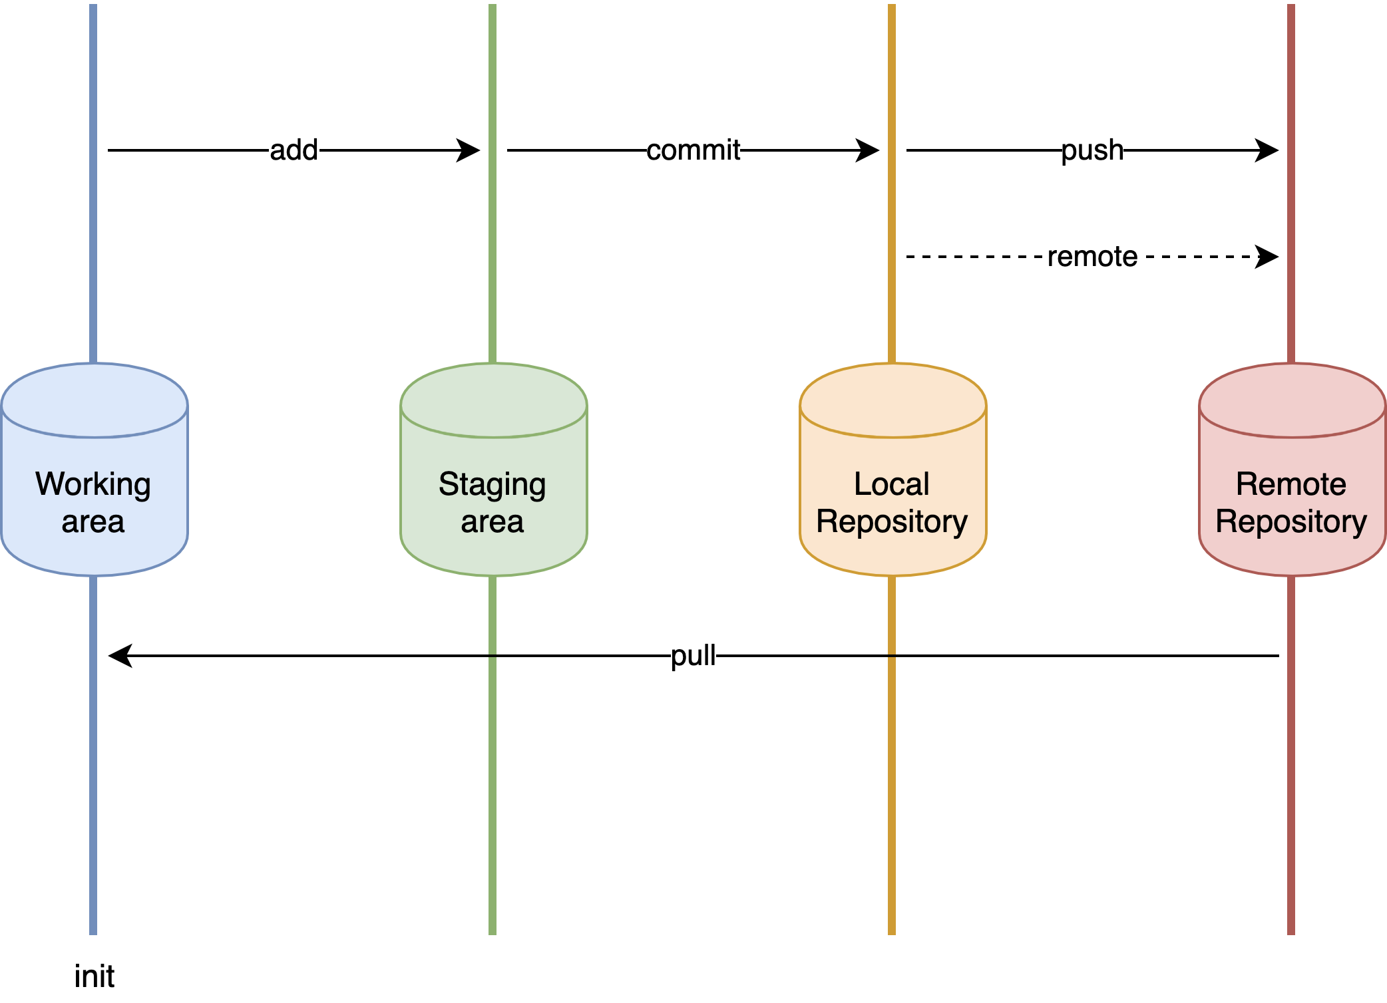

Slide 45
4.
Advanced Git commands

Slide 46
4. 1
View history

Slide 47
Logging
git log <object>
Review the history of committed snapshots.

Slide 48
Difference
git diff <path> <path>
Explore differences between the workspace, the staging area, and commits.

Slide 49
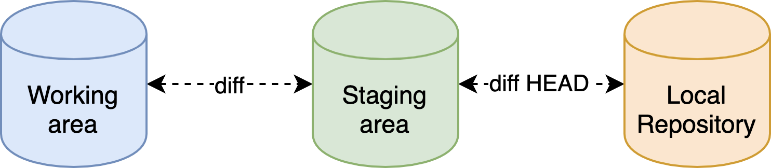
Difference
git diff <path> <path>

Slide 50
Tagging
git tag <tag-name>
Another way to track the history of a repository via certain milestone commits.

Slide 51
4. 2
Recovery

Slide 52
Checkout
git checkout “<commit>”
Explore the state associated with a specific commit.

Slide 53
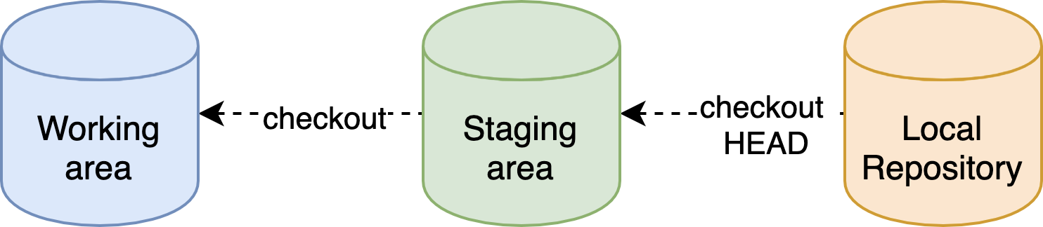
Checkout
git checkout “<commit>”

Slide 54
Reset
git reset [--soft | --hard] <commit>
Return to a previous state, effectively erasing subsequent commits.

Slide 55
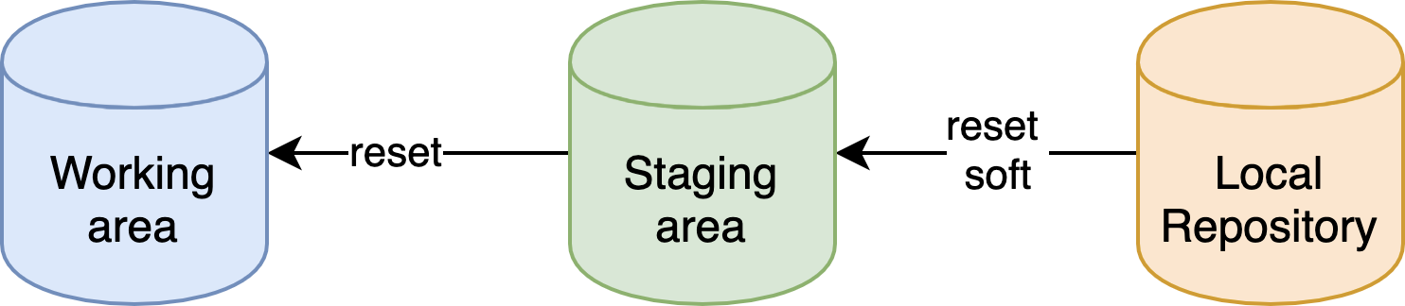
Reset
git reset [--soft | --hard] <commit>

Slide 56
Revert
git revert <commit>
Generate a new commit that reverses the changes introduced by a commit.

Slide 57
4. 3
Branching

Slide 58
Branching
Isolating environment from main development line without impact.
For example, developing new features without affecting production-quality code.
Encouraging experiment purposes.

Slide 59
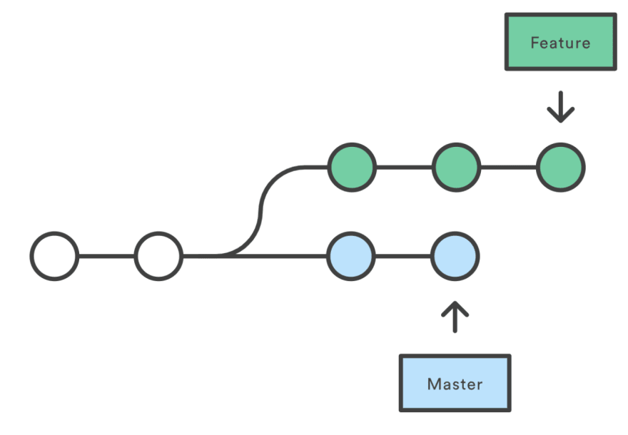
Branching example
Notes:
https://www.atlassian.com/git/tutorials/merging-vs-rebasing

Slide 60
Branching
git branch <branch-name>
Take edits in the project in a new direction to allow for modifications that will not affect the main branch.

Slide 61
Merging
git merge <branch-name>
Incorporate changes in a branch into another branch (typically master).

Slide 62
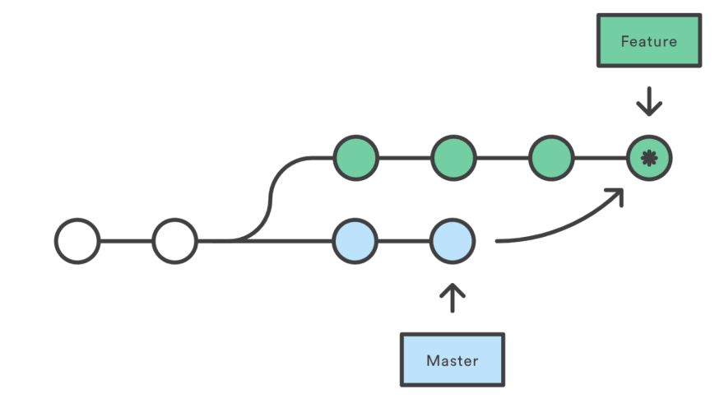
Merging
Notes:
https://www.atlassian.com/git/tutorials/merging-vs-rebasing

Slide 63
Rebasing
git rebase <branch-name>
Apply all changes of a branch on top of another branch by creating a new commit.

Slide 64
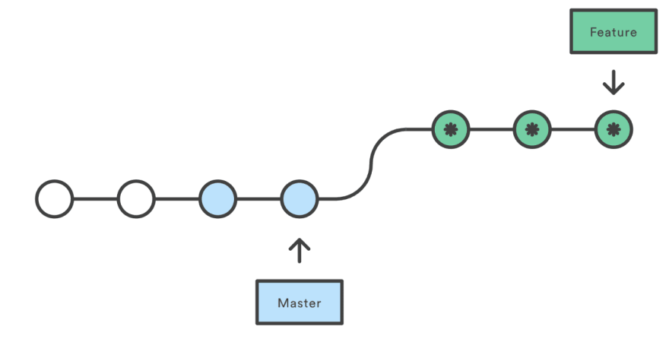
Rebasing
Notes:
https://www.atlassian.com/git/tutorials/merging-vs-rebasing

Slide 65
Merging vs Rebasing
Safety vs Traceability
Notes:
https://www.atlassian.com/git/tutorials/merging-vs-rebasing

Slide 66
Stashing
git stash [pop | apply | list | clear]
Record the current state of the working directory and the index, but want to go back to a clean working directory.

Slide 67
5.
Git-related files

Slide 68
.gitignore
Ignore files that we don't want to get staged and committed.

Slide 69
.gitconfig
Git configuration file contains a number of variables that affect the Git commands' behavior.

Slide 70
6.
Resolving conflicts

Slide 71
7.
Git and DevOps

Slide 72
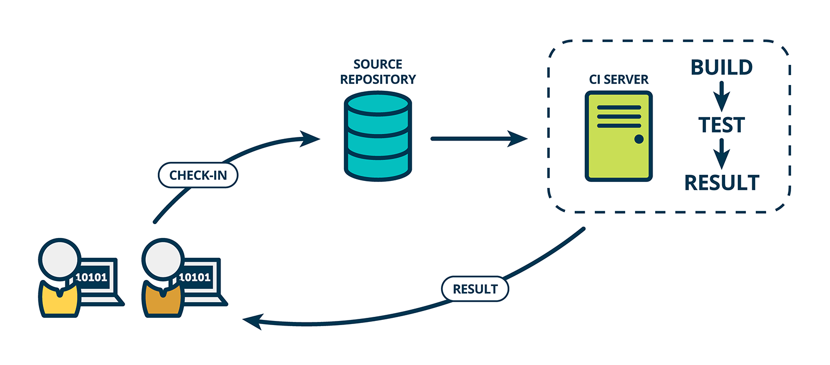

Slide 73
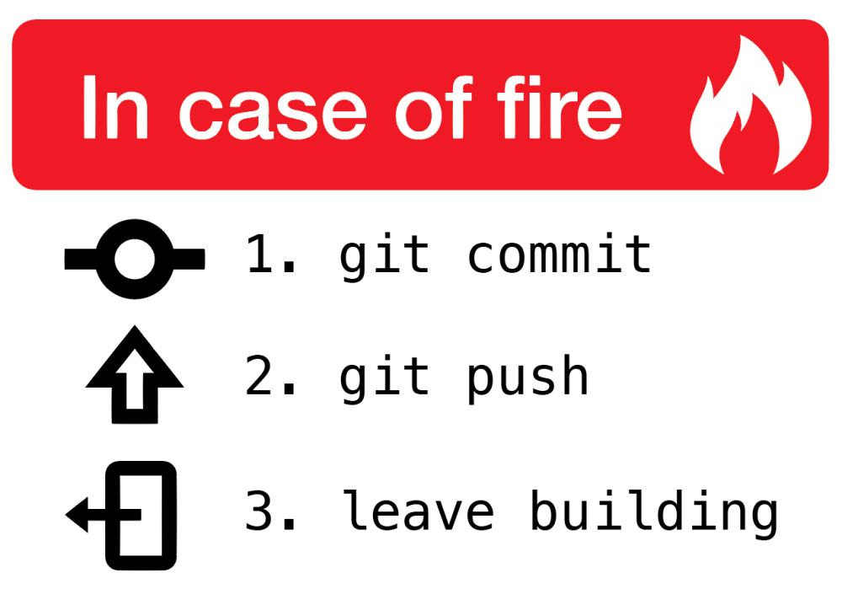
Notes:
https://medium.com/@pakin/git-%E0%B8%97%E0%B8%B3%E0%B9%84%E0%B8%A1-commit-message-%E0%B8%96%E0%B8%B6%E0%B8%87%E0%B8%AA%E0%B8%B3%E0%B8%84%E0%B8%B1%E0%B8%8D-accdf82cbd82

Slide 74
8.
Productivity tools

Slide 75

Text editors / IDE

Slide 76
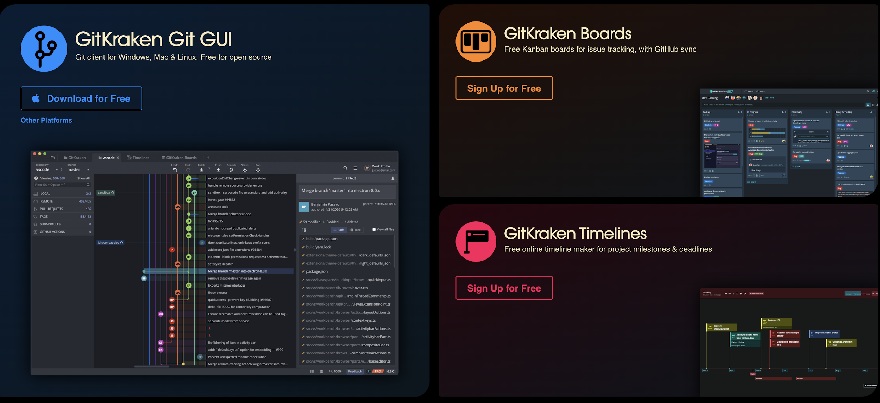
Git Kraken

Slide 77
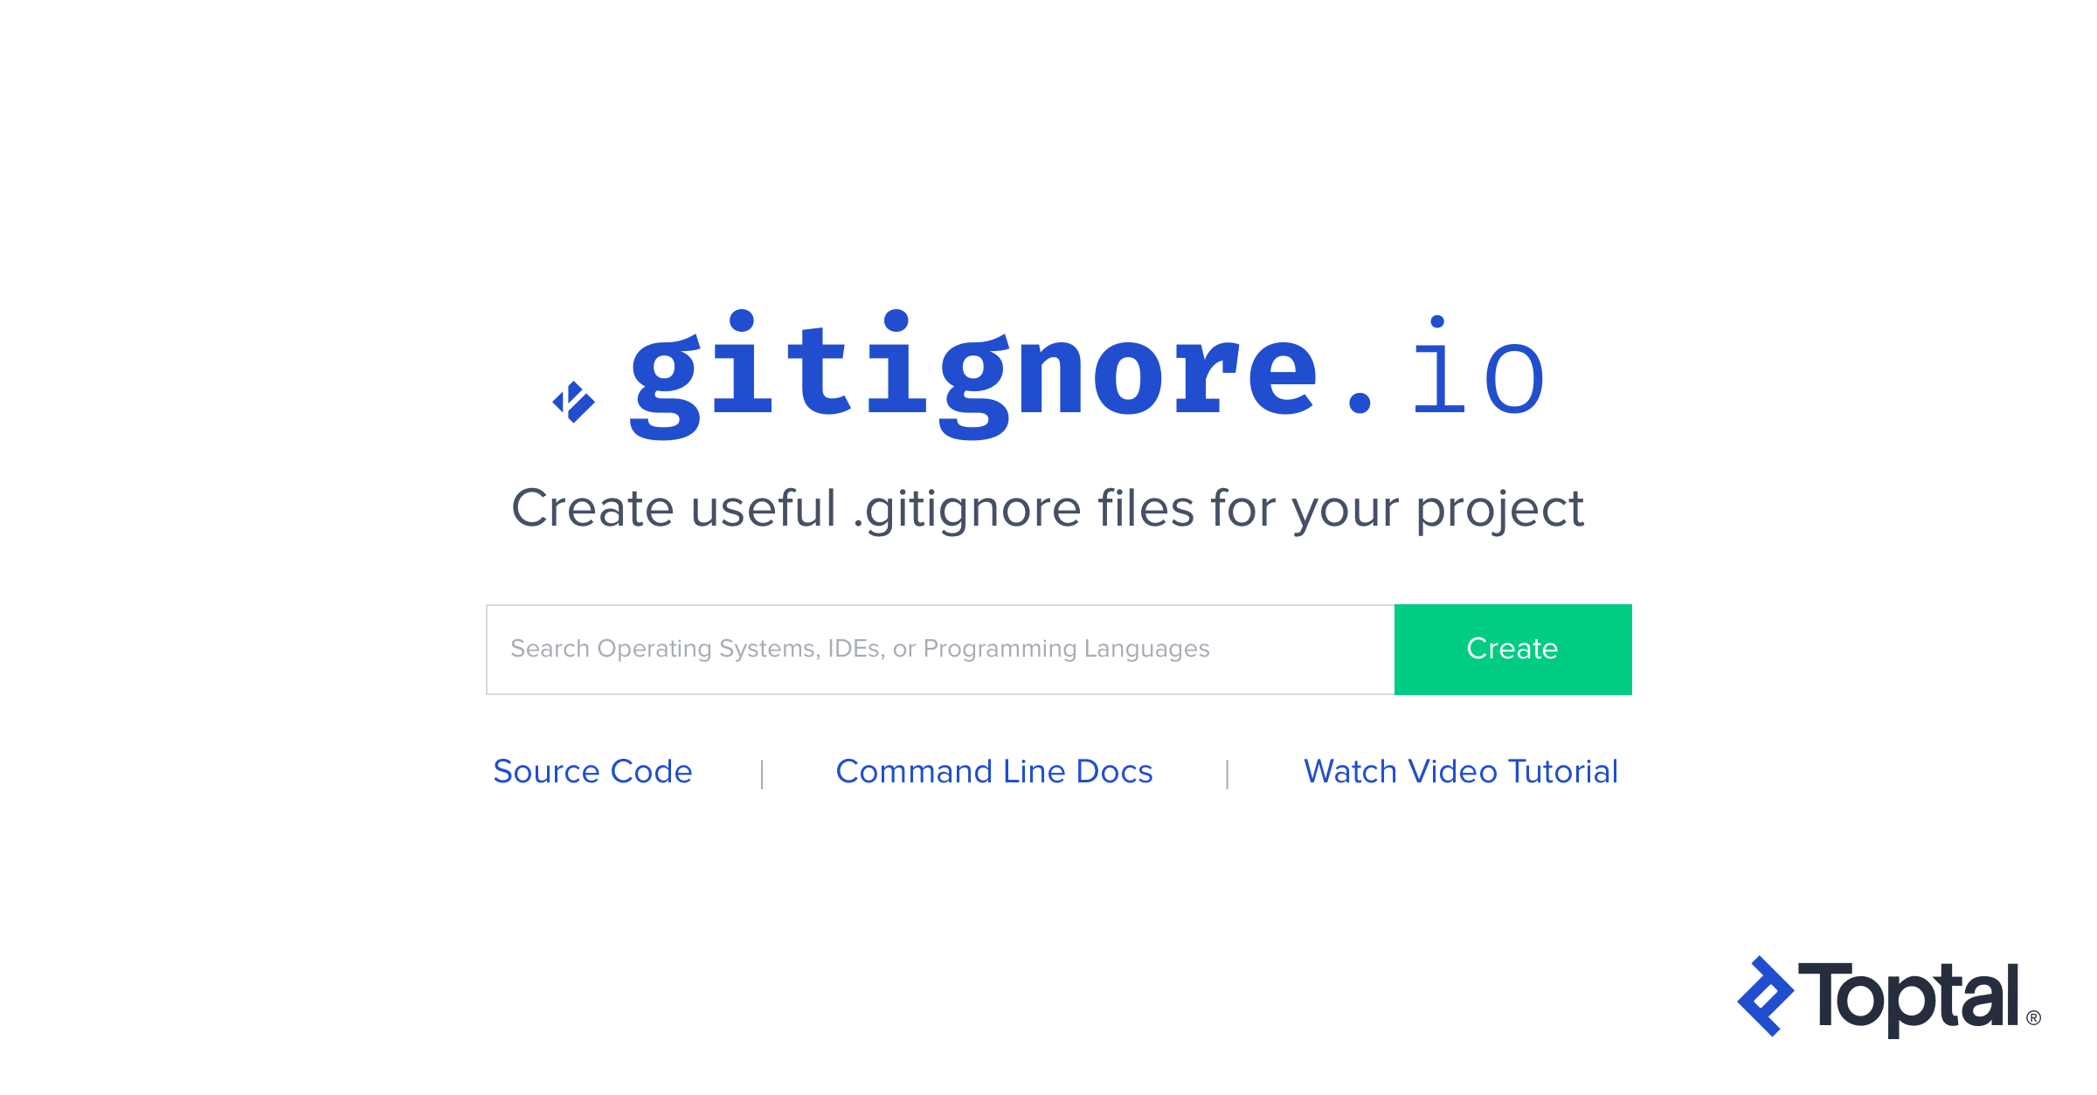
gitignore.io

Slide 78
Thanks!
Contact us:
Raksit Mantanacharu
raksit.mantanacharu1@exxonmobil.com

